Slide 1
BANK MARKETING ANALYSIS
Course: Data Analysis and Decision Making
Instructor: Prof. Douglas H. Jones
Period: Fall 2017
Date:12/04/2017
By : - Anupam Tiwari
Jinil Amin Prachi Hota

Slide 2
Agenda
Introduction
Business Questions
Model
Software and Installed Packages
Data Analysis Procedure
Data Visualization
Results
Conclusion

Slide 3
Introduction
We have Bank marketing data which is derived from the direct marketing campaigns of a Portuguese banking institution. The marketing campaigns were based on phone calls.
The goal of our analysis is to understand the essential features affecting short-term deposit account for sign-ups and to develop a plan to help banks focus on those most promising leads to attract more customer.

Slide 4
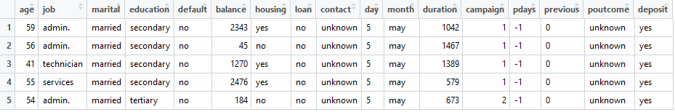
Data Set Description
The dataset used here is from Kaggle however original dataset belongs to UCI machine learning website.
The following categories of information are included in the data set:
Consumer data: Age, sex, job and marital status, education, loan status, and so on.
Campaign activities: When and how to contact, times to contact, outcome of previous campaigns.
Outcome: A 'yes' for the bank if there is a term deposit subscribed, a 'no' for the other outcome.

Slide 5
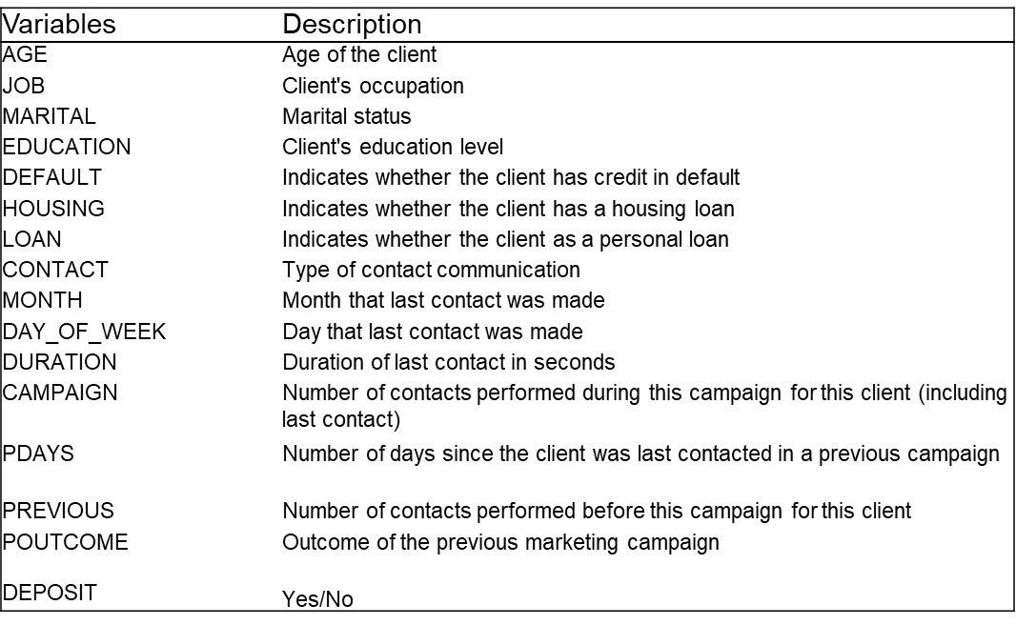
Variable Description

Slide 6
Business Questions
Can a potential customer’s demographic data be used to predict if he/she will subscribe for a term deposit?
Can we arrive at leads that can be targeted for business?

Slide 7
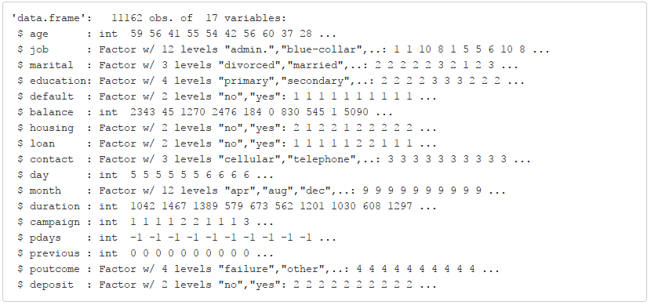
Model: Data Structure

Slide 8
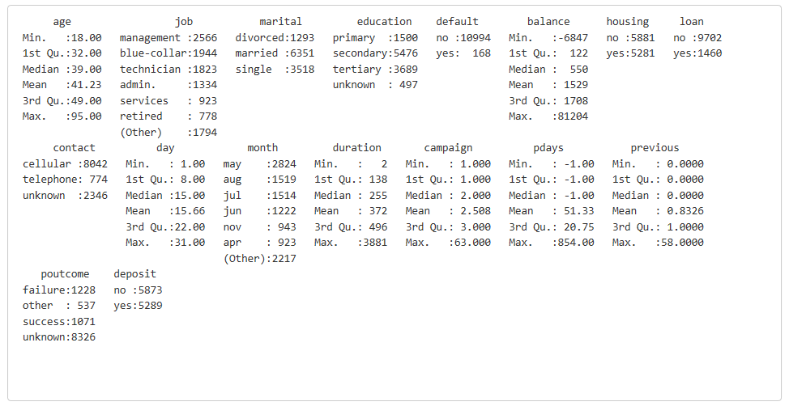
Model: Data Summary

Slide 9
Model: Methodology
Logistic Regression Model:
This nonlinear function is a sigmoidal function of the model terms and constraints the probability estimates to between 0 and 1
model3 <- glm(deposit ~ job + marital + education + balance + housing + loan + contact + month + duration + campaign + poutcome,
data = trainD, family=binomial(link='logit’))
Prediction:
Predicted the test data on the training data
model with 95% confidence interval.

Slide 10
Software and Installed Packages
Software:
R Studio
Installed Packages:
caret, MASS, ROCR, readr, faraway, pscl and, e1071

Slide 11
Data Analysis Procedure
Data Pre-processing
Exploratory Analysis
Model Building
Diagnostic and Selection
Prediction
Conclusion

Slide 12
Data Visualization

Slide 13
Results
Predicted whether the client will subscribe to the term deposit by creating logistic regression model.
Using data visualization, we got the leads to target for improving the business.

Slide 14
Conclusion
Applying machine learning techniques to retail banking data, we conclude that these models can be used to conduct further marketing campaign and improve the business.

